Slide 1




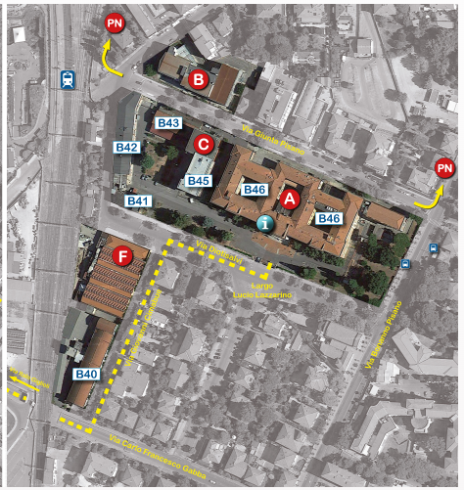
SEMINARIO INTERNAZIONALE
Traffic safety education
and smart road pricing
Innovative Approaches to Road Safety Education for Children
Prof. Aleksandar Trifunović
Associate Professor · Faculty of Transport and Traffic Engineering
University of Belgrade
Road Pricing and Tolling Technologies
Prof. Draženko Glavić
Full Professor · Faculty of Transport and Traffic Engineering
University of Belgrade
MARTEDÌ 6 OTTOBRE 2026
10:30 – 12:30
Aula Guerrini (secondo piano edificio B42 - Dipartimento Ing. Meccanica, Nucleare e della Produzione)
Ingresso libero · Seminar in English

